Slide 1

My Daily Routine

Slide 2
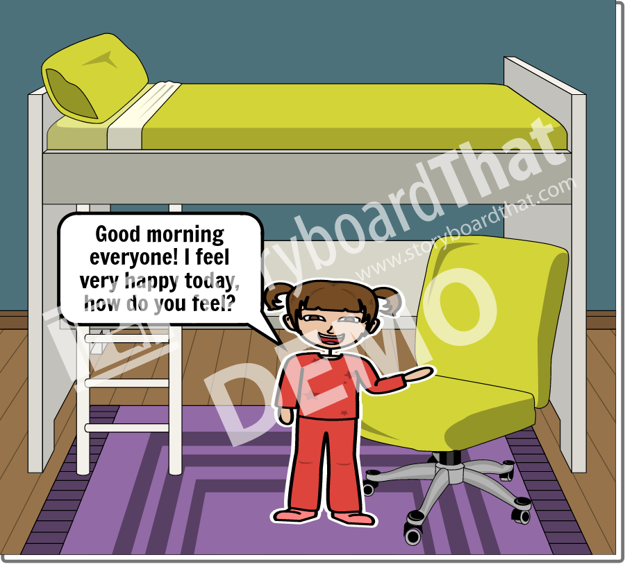
Add Title Here
Add Text Here

Slide 3
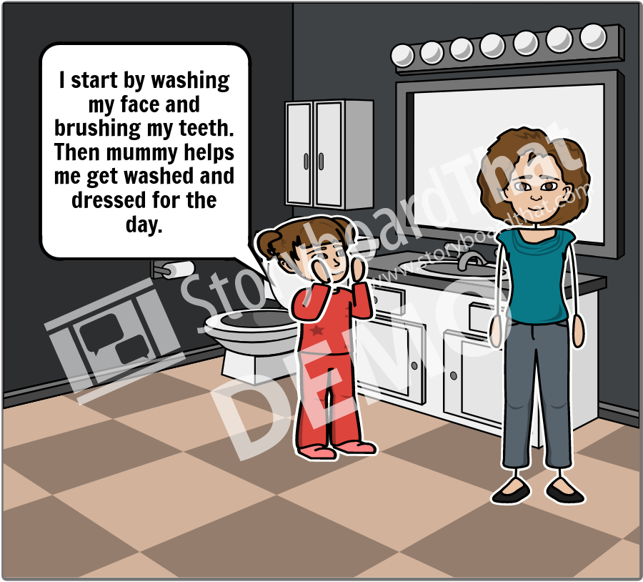
Add Title Here
Add Text Here

Slide 4
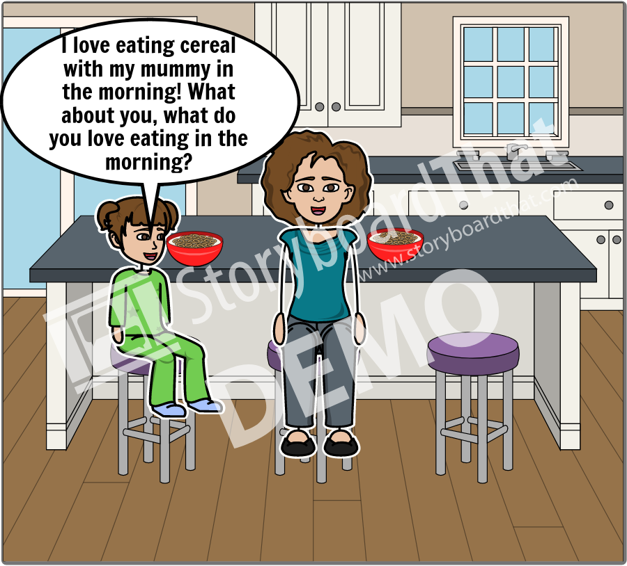
Add Title Here
Add Text Here

